Slide 1
DIGITAL LOGIC DESIGN PROJECT
Smart Parking Slot Availability
& Entry Control System
Design and Simulation using Combinational Logic
Simulated in Logisim • Version-controlled on GitHub

Slide 2
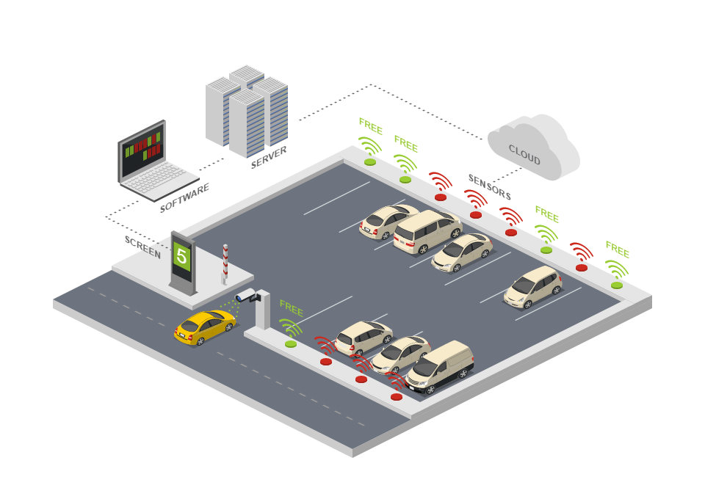
PROBLEM STATEMENT
Why Automate Parking Entry?
Current Limitations
Manual gatekeeping cause delays and queuing at peak hours
Drivers have no real-time visibility into free vs. occupied slots before entering
Manned checkpoints do not scale well and add recurring staffing cost
Software/microcontroller-based systems add cost, boot latency and points of failure for a decision that is fundamentally a simple, fixed logic rule
Goal: zero-latency, deterministic entry control
Smart Parking Slot Availability & Entry Control System
2

Slide 3
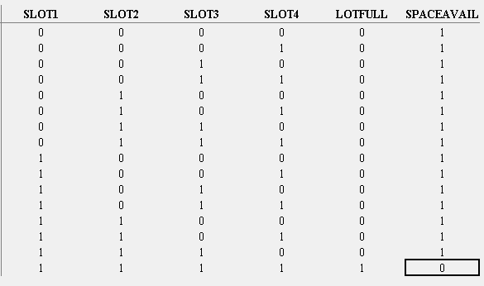
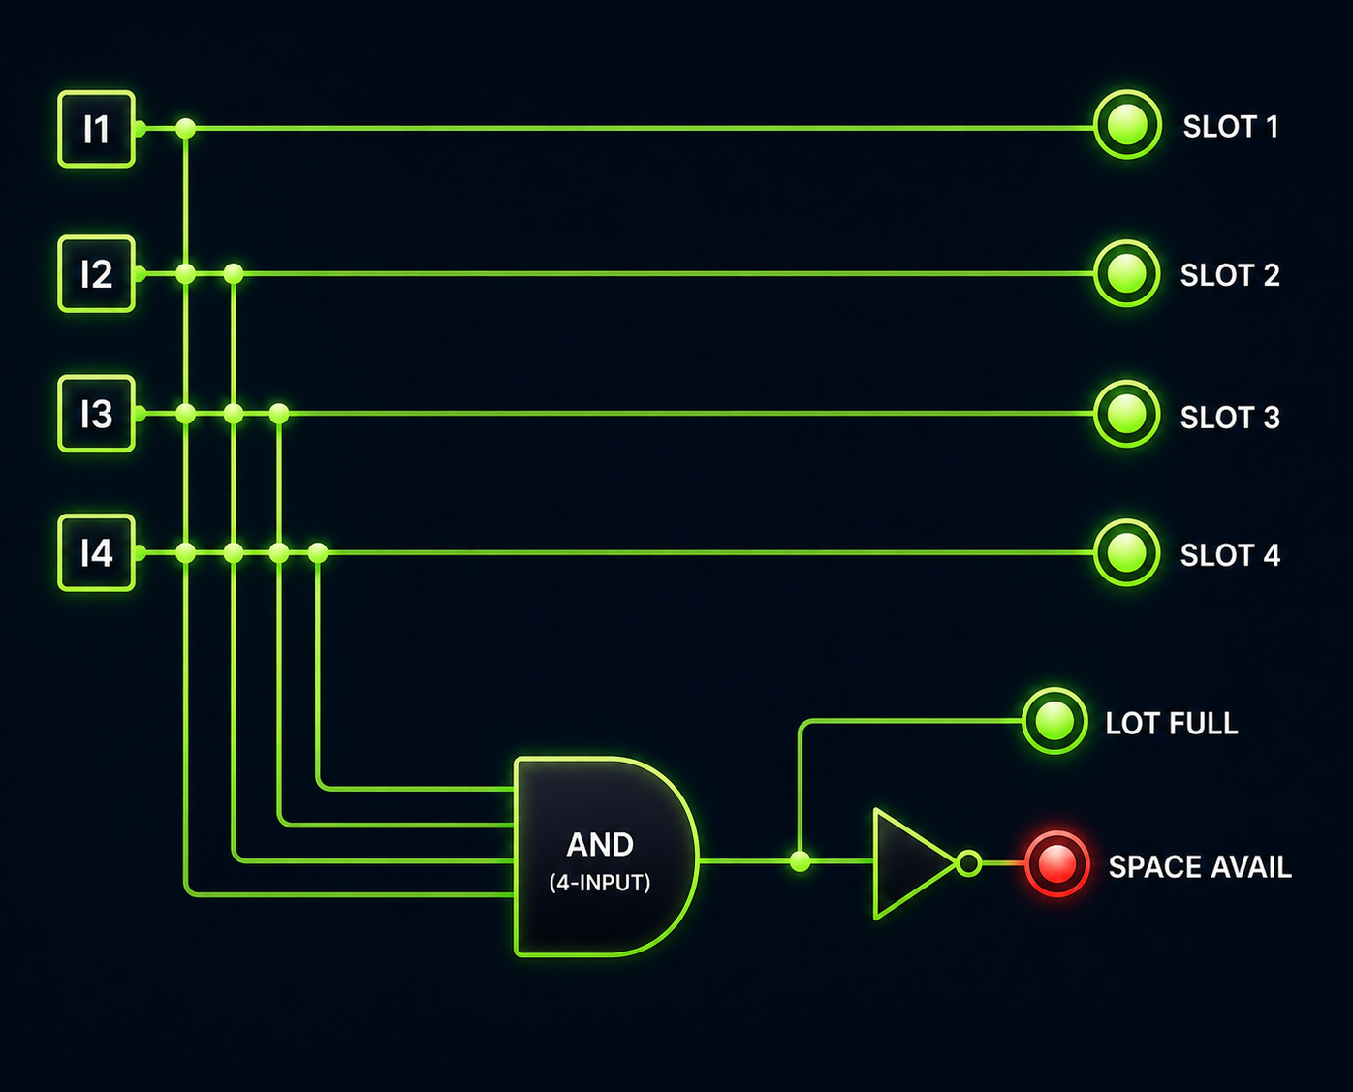
DESIGN & METHODOLOGY
From Truth Table to Gate-Level Circuit
Truth Table
Gate-Level Circuit
Smart Parking Slot Availability & Entry Control System
3

Slide 4
SIMULATION & DEMO
Simulating the Circuit in Logisim
1
2
3
4
Wiring
Run and labelling
Place the Inputs
Add the Logic Gates
Place four input pins vertically on the left side of your workspace.
These will act as the sensors for your four parking slots
Place a 4-input AND gate below the main input lines, towards the center-bottom of your workspace.
Place a NOT gate to the right of the AND gate's output.
Slot Outputs: Draw straight wires from each of the 4 input pins directly across to the top 4 output pins.
AND Gate Inputs: Create a junction on each of those 4 main input wires. Route a wire from each junction down into the 4 input nodes of the AND gate.
Lot Full Output: Connect the output wire of the AND gate straight across to the 5th output pin.
NOT Gate Connection: Create a junction on the AND gate's output wire (before it reaches the pin). Route this into the input of the NOT gate.
Space Avail Output: Connect the output of the NOT gate to the final 6th output pin.
Label the Outputs: Name the top four output pins "SLOT 1", "SLOT 2", "SLOT 3", and "SLOT 4". Name the 5th output pin "LOT FULL" and the 6th output pin "SPACE AVAIL".
Label the Inputs: Name the four input pins to correspond with slots 1 through 4.
Run the Circuit: Start the simulator and toggle the inputs to test it.
If any input is 0, "SPACE AVAIL" will light up (1).
If all inputs are 1, "LOT FULL" will light up (1) and "SPACE AVAIL" will turn off (0).
Demo artefact:
a .circ Logisim file plus recorded switch-toggle test cases showing the gate opening only when Gate_Open = 1.
Smart Parking Slot Availability & Entry Control System
4

Slide 5
GITHUB REPOSITORY
Project on GitHub
smart-parking-combinational-logic /
Conclusion
|-- KLH-FED-2026-Session-10-Batch-10
A software-free parking entry system: truth tables and K-maps drive a gate-level design, simulated and verified in Logisim, and version-controlled on GitHub for transparency and reuse.
| |-- readme.md
| |-- Smart Parking System presentation.pptx
| |-- Smart Parking System.circ
Truth Tables
K-Maps
Logisim
GitHub
Thank You
Smart Parking Slot Availability & Entry Control System
5

